Slide 1

House Price Prediction
NEIL SONALKAR

Slide 2
Overview
Problem: How to determine house price?
Steps:
Data Cleaning and wrangling
Exploratory data analysis
Statistical analysis
Machine learning modeling
Evaluating

Slide 3

House Price Prediction is essential for
Realtors, Real Estate Investors and Homeowners

Slide 4
Solutions
Data Wrangling
EDA
Create Visualizations
Statistical Analysis
Process Missing Data
Preprocess categorical data to dummy table
Normalize data
Perform Outlier Treatment
Check for correlated features
Get data structured for analysis and modeling
Hypothesis Testing
Analyze Trends

Slide 5
Solutions (Cont.)
Machine Learning
Evaluation
R-Squared Adjusted
Data Analysis
Run Regression Algorithms on Data
Cross Validate
Hyperparameter Tuning
Predict Prices
RMSE
Compare against all algorithms
Recommend Algorithm that performed the best (Explain Process)
Recommend what to look for when buying a house (Important Features)

Slide 6
Results
Regression Algorithms | R-Squared Adjusted
Linear Regression | .789
SVM | .849
Random Forest | .874
Gradient Boosting | .884
Comparison of different regression models:

Slide 7
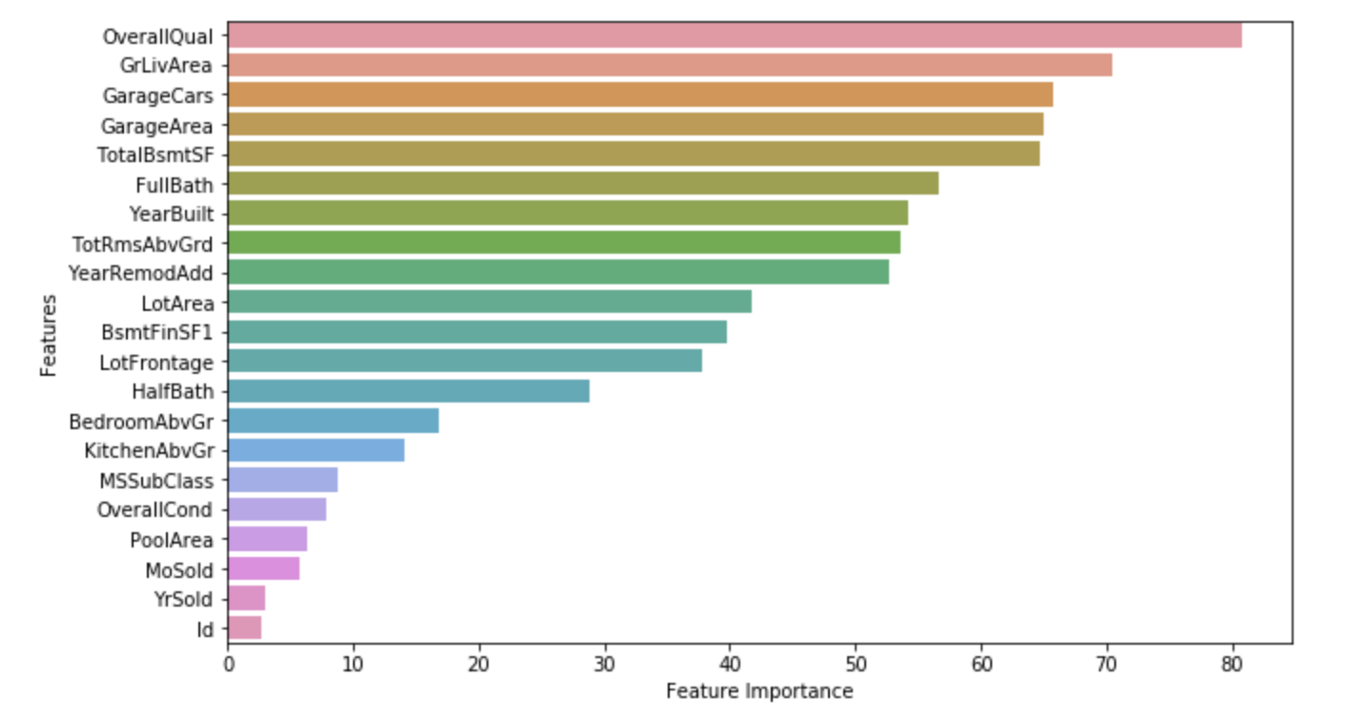
Feature importance hierarchy:
Strongest Independent Features
Quality
Ground Living Area
Garage Area
Total Basement Sqft
Weakest Independent Features
Pool Area
Month Sold
Year Sold
Overall condition

Slide 8
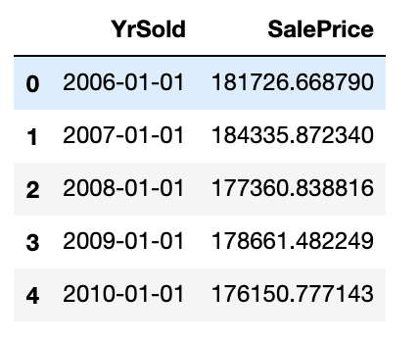
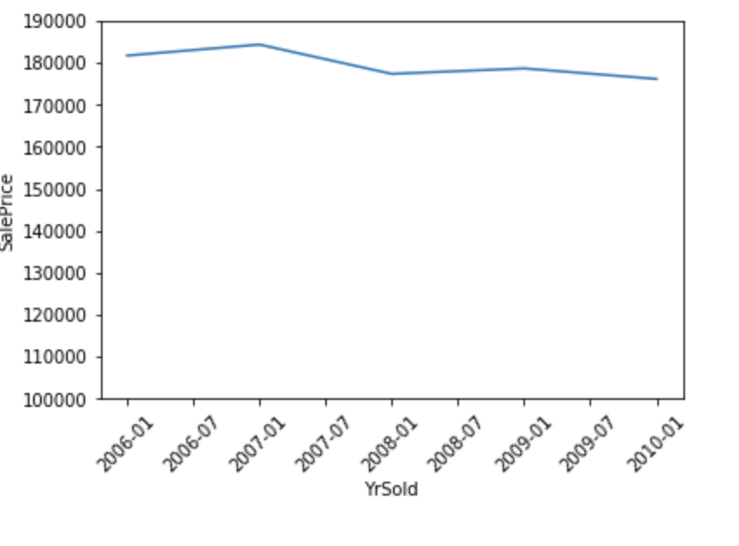
Price Check
We see a slight decrease in the mean house price of houses sold in 2010

Slide 9
Time series view:
Age of house and Sale Price correlation over time.
We see in green the sales price of each house that was built in that year. We see in red, the age of the house before being sold.
We see a negative correlation along time between the two.

Slide 10

Solutions:
Real Estate Investor:
If a real estate investor was looking to sell one of their properties, avoid selling in 2010. Buyers Market. Low risk properties
Important features:
Area of: Basement, Living, Garage
Overall Quality
Real Estate Agents:
Know how to determine a price point based on the important features of the house.
Home Buyers:
Level of transparency on house costs when buying and selling homes.

Slide 11
Recommendations and Future Work :
Primary Recommendations:
Find external features that might correlate with House Price. Ex) Crime rate, school district, population rate, etc.
Find more instances of Townhomes and Condos. Majority of data was single family homes.
Future Work:
Create a program that allows clients to enter the important features of a house to determine the house price.
Find more recent data.

